Slide 1

IOT for monitoring water bodies
Team gce
Government college of engineering, Tirunelveli
Notes:
Choose any one of the application from the below link:
https://www.mistralsolutions.com/hackfest/

Slide 2
IOT FOR MONITORING WATER BODIES
Nellai Smart water monitoring system(NSWMS):
“Neerindri amayathu ulagu”
Nellai smart water monitoring system is for monitoring quality of water in river and much more.
Using adafruit-io we create dashboards for making data powered decision
Esp32 and Esp8266 used for pushing the data to feeds of adafruit-io.
Notes:
Mention the number of challenges being undertaken and a broad description (about 3-4 sentences) for the overall proposed solution for the chosen application.

Slide 3
Components used:
Sensors used:
DHT11- for monitoring temperature and humidity.
Water flow sensor(YF-S201)-for water current.
Water level sensor(SEN18)-for depth of water.
TDS sensor- for Total dissolved solids
pH sensor(with 9 v battery)- for getting pH value
Software used:
Arduino IDE – embedded c
Notes:
Provide the challenge name and a write-up of the proposed solutions along with screenshots, wireframes, block diagram or sketches, if any. Also, explain the type of proto you will be providing during the demo.
Note: This slide needs to be created for each of the challenges being addressed.

Slide 4
Description
As per WHO ,diarrheal diseases associated with lacking of hygiene results in death of thousand children per day across the world.
For conserving resource like Tamiraparani river.
NSWMS:
The system will send alert mail if any parameter were gone out of range .
It will continues measures the required parameters and send it to feeds .
The adafruit –io platform will give us dashboards using feeds.
We can also set various protocol for parameters and customize the dashboard.
Notes:
Provide the challenge name and a write-up of the proposed solutions along with screenshots, wireframes, block diagram or sketches, if any. Also, explain the type of proto you will be providing during the demo.
Note: This slide needs to be created for each of the challenges being addressed.

Slide 5
Working flow:
Data collection
Data transmission and management
sensors
Controller
cloud
Adafruit-io
sensors
Create dashboard and stores data
Notes:
Provide the challenge name and a write-up of the proposed solutions along with screenshots, wireframes, block diagram or sketches, if any. Also, explain the type of proto you will be providing during the demo.
Note: This slide needs to be created for each of the challenges being addressed.

Slide 6
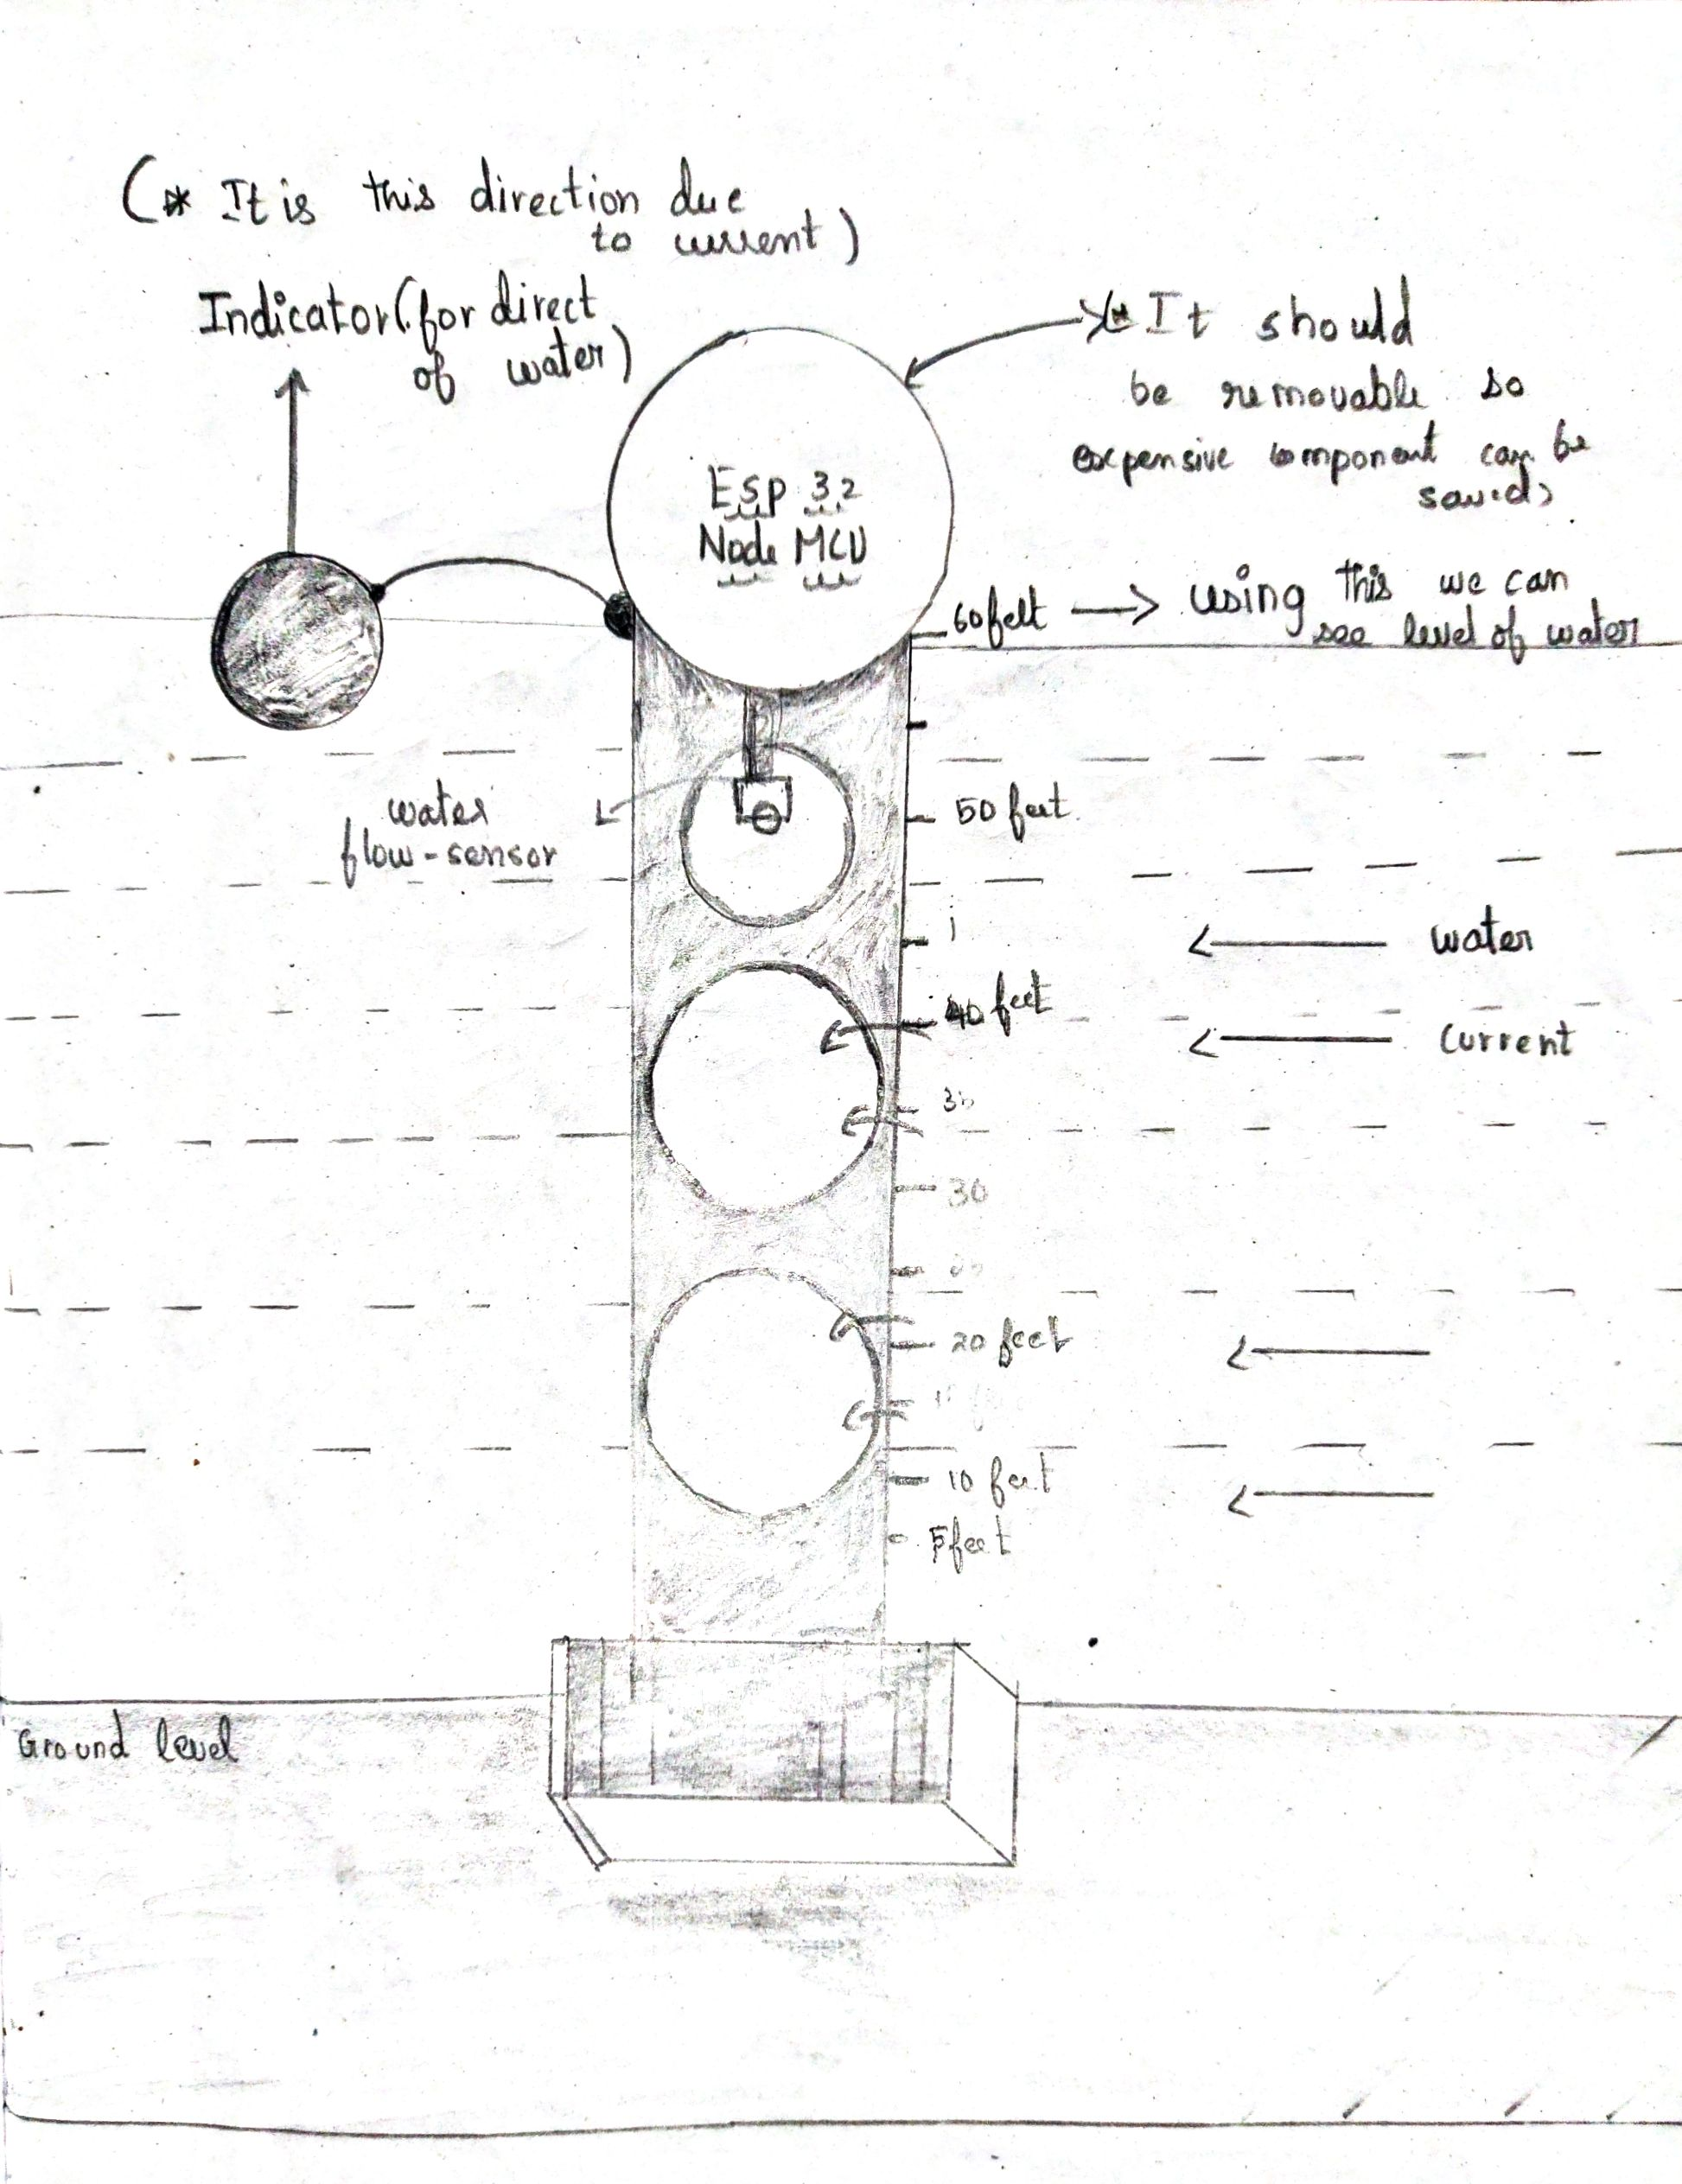
Picture of model
Top
indicator
Water level indicator
middle
Bottom
Notes:
Provide the challenge name and a write-up of the proposed solutions along with screenshots, wireframes, block diagram or sketches, if any. Also, explain the type of proto you will be providing during the demo.
Note: This slide needs to be created for each of the challenges being addressed.

Slide 7
Structure :
Bottom section :
The base part of the model is made-up of concrete .
Middle section:
The middle section is pipe with few holes ,which will reduce the force of water against the model .
There was physical water level indicator .
Top section:
Esp32 and Esp8266 are placed at the top specially above water .
These modules are kept in a closed environment , since water will damage our devices.
Other sections: indicator to show the direction of the water.
Notes:
Provide the challenge name and a write-up of the proposed solutions along with screenshots, wireframes, block diagram or sketches, if any. Also, explain the type of proto you will be providing during the demo.
Note: This slide needs to be created for each of the challenges being addressed.

Slide 8
Solutions:
Challenge 2:
For power – solar plane can be implemented.
For connectivity – wifi router like jio router.
Alert using mail for damage / theft .
Challenge 4:
Esp32-cam uses OpenCV for getting real time video.
We use coco dataset for model.
There is a Cvlib library that uses an AI model for detecting objects.
Then we use multiprocessing which utilizes multiple cores of our CPU.
INMP441 is used to get audio.
.
Notes:
Provide the challenge name and a write-up of the proposed solutions along with screenshots, wireframes, block diagram or sketches, if any. Also, explain the type of proto you will be providing during the demo.
Note: This slide needs to be created for each of the challenges being addressed.

Slide 9
Faq:
What is the use of this project?
Using this system we can conserve and restore the water resource of tamiraparani river.
Why you choose adafruit-io?
There are many io platform like blynk , thinkspeak , and much more.
Adafruit-io is more user friendly and suits our project perfectly.
Notes:
Provide the challenge name and a write-up of the proposed solutions along with screenshots, wireframes, block diagram or sketches, if any. Also, explain the type of proto you will be providing during the demo.
Note: This slide needs to be created for each of the challenges being addressed.

Slide 10
Links:
Adafruit – io link:
https://io.adafruit.com/AGS_Jimson/dashboards/nswms?kiosk=true
GitHub Link for code:
https://github.com/JimsonAGS/NSWMS
Notes:
Provide the challenge name and a write-up of the proposed solutions along with screenshots, wireframes, block diagram or sketches, if any. Also, explain the type of proto you will be providing during the demo.
Note: This slide needs to be created for each of the challenges being addressed.

